Slide 1
6.1-6.3 Subset Selection
Eleanor Howe 12/19/2014

Slide 2
Alternates to least-squares
Improve Accuracy
least-squares is ideal where n>>p
Not as good if n>p
Linear equations do not solve if n<<p
Improve Interpretability
Remove irrelevant predictors

Slide 3
6.1.1 Best Subset Selection
Try all possible combinations of p predictors
Choose the best one
Advantages: exhaustive, simple.
Disadvantages: takes too long : 2^{p} possible models must be evaluated.
Enormous search space may lead to overfitting.

Slide 4
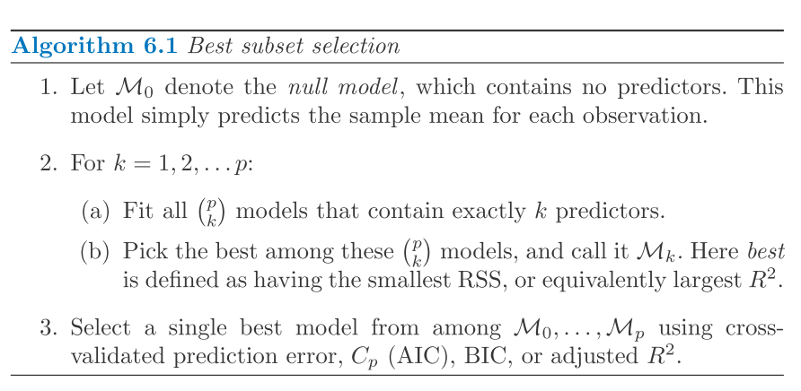
Algorithm: Best Subset Selection

Slide 5
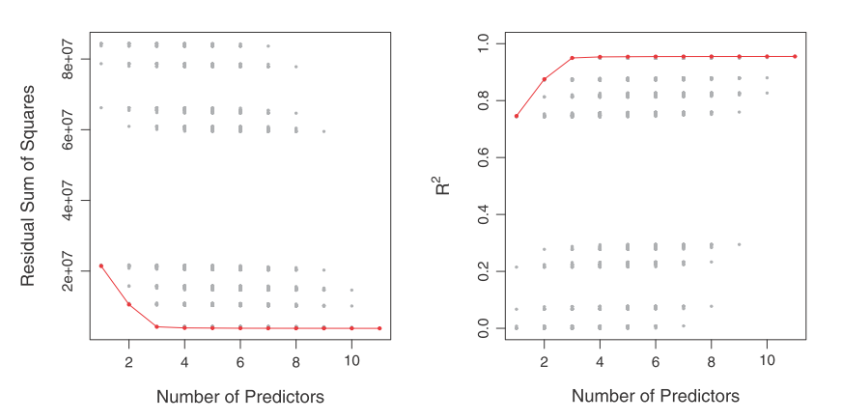
Figure 6.1
Notes:
FIGURE 6.1. For each possible model containing a subset of the ten predictors
in the Credit data set, the RSS and R^2 are displayed. The red frontier tracks the
best model for a given number of predictors, according to RSS and R^2. Though
the data set contains only ten predictors, the x-axis ranges from 1 to 11, since one
of the variables is categorical and takes on three values, leading to the creation of
two dummy variables.

Slide 6
6.1.2 Stepwise Selection
Stepwise methods explore a more restricted set of models, reducing overfitting and reducing time to select/fit the model.
Three types:
Forward Stepwise
Backward Stepwise
Hybrid Approaches

Slide 7


Forward Stepwise Selection
Begins with a model containing no predictors
Adds one-at-a-time the predictor that gives the greatest improvement to the model, until all predictors are added.
Of all of the models created, the “best” is chosen using cross-validation.
number of models created in FSS:
for p=20:
211 models made
number of models created in BSS:
for p=20:
1,048,576 models made

Slide 8
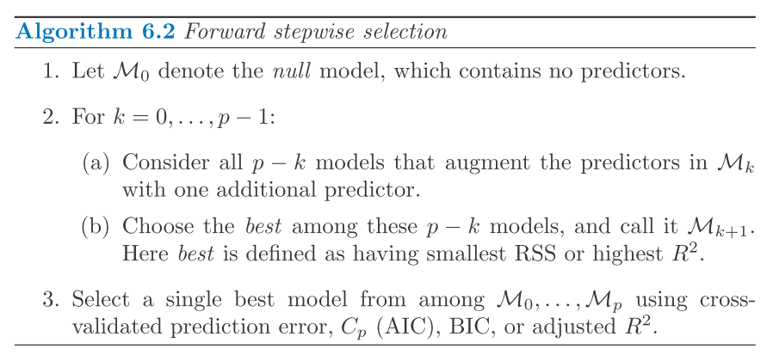
Algorithm: Forward stepwise selection

Slide 9
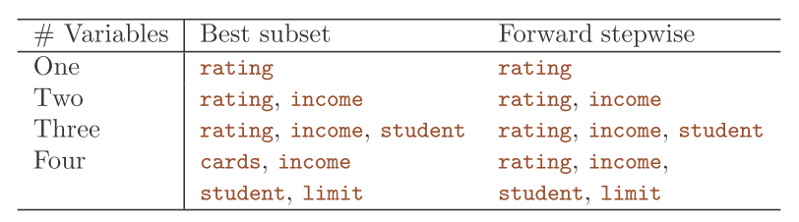
Forward Stepwise Selection
Advantages: faster than best subset selection
Tractable for problems with p > 40
Usable for models where n < p, but only for models with n-1 or fewer predictors
Disadvantages:
Not guaranteed to produce the best possible model

Slide 10
Backward stepwise selection
Works in reverse from Forward stepwise selection:
A model is built including all predictors
At each step, the least-predictive is removed
Of each of the models produced by each step, the best model is selected.
Like FSS, BSS is not guaranteed to produce the best subset model.
Searches smaller space than 2^{n}.
Cannot be used when n<p.

Slide 11
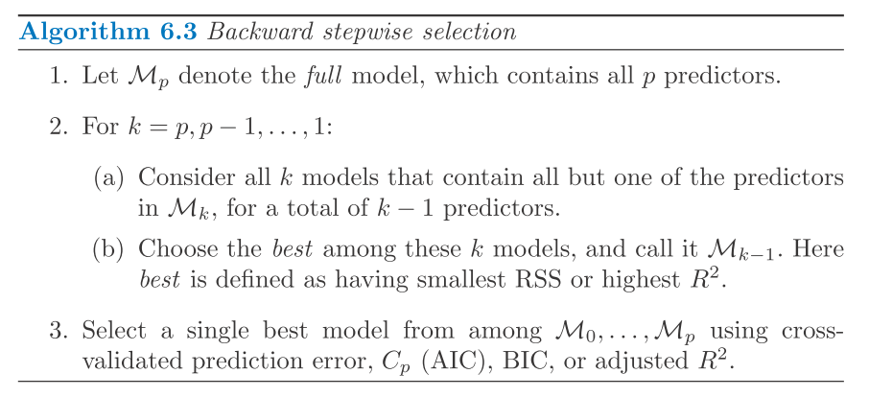
Backward stepwise selection

Slide 12
Hybrid approaches
Hybrid approaches attempt to combine both forward and backward selection to produce a model with closer to a “best subset” fit with a computational complexity of the forward or backward selection method.
These models begin with a null model and add predictors as with forward selection. At each step, they also remove predictors that are less-informative, as with backward selection.

Slide 13
6.1.3 Choosing the Optimal Model
“The model containing all of the predictors will always have the smallest RSS and the
largest R², since these quantities are related to the training error.”
The optimal model will have a low test error.
Estimating test error
Adjust the training error to account for bias
Directly estimate with cross-validation or a validation set

Slide 14
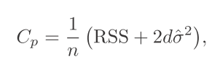
C_{p}
Fit for least-squares models.
An unbiased estimate of MSE, if σ² is an unbiased estimate of σ².
σ² is an estimate of the variance of the error ϵ associated with each response element in the linear regression equation
The penalty increases with an increasing number of predictors, d.
Choose a model with a low value for C_{p}.
^

Slide 15


AIC and BIC
AIC: defined for models fit by maximum likelihood.
Proportional to C_{p} for least-squares models.
For the linear model with gaussian errors, maximum likelihood and least-squares are the same.
BIC: defined for models fit by least squares.
Heavier penalty on the number of predictors than C_{p}.

Slide 16

Adjusted R²
Regular R₂ always increases with added predictors.
The Adjusted R₂, is corrected for the number of predictors d, such that it may decrease as additional, less-informative predictors are added to the model.
A large value of Adjusted R₂ indicates a model with low test error.

Slide 17
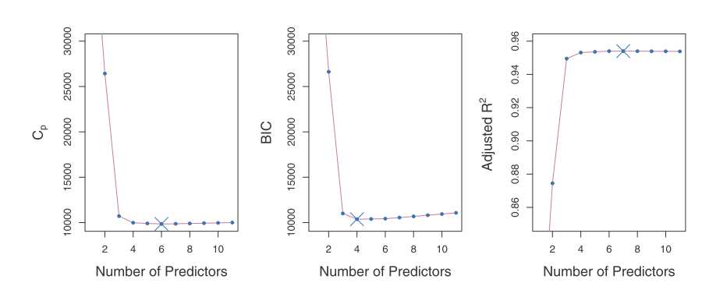
Values of C_{p}, BIC and Adjusted R₂ for the credit data set.

Slide 18
Validation and Cross-Validation
An alternative to calculating AIC/BIC/C_{p}/R²
Directly estimate the error for the validation set, or the error for cross-validation for each model, and select the model with the smallest error.
Makes fewer assumptions about the true underlying model
Usable when it is difficult to pinpoint the number of predictors in the model (d), or when it is difficult to estimate the error variance σ².

Slide 19
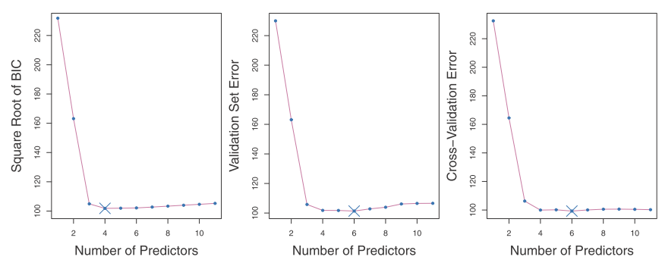
One-standard-error rule: Select the smallest model with an estimated test error within one standard error of the lowest point on the curve.
Standard error: standard error of test MSE for each model size.
Notes:
Comparison of BIC, validation adn cross validation. Both of the latter give more predictors in the optimal model.

Slide 20
One-standard-error rule
Model-selection method.
Calculate the standard error of test MSE for each model.
Select the smallest model for which the estimated test error is within one SE of the lowest point in the curve.

